Slide 1

Precedence & Persistence Logic
April 2025
Amanda Chenery

Slide 2
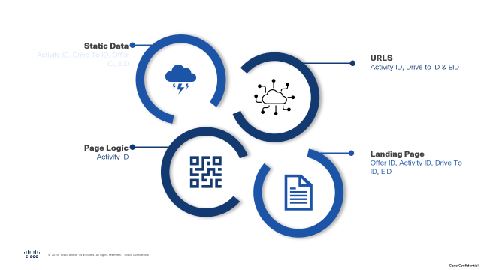

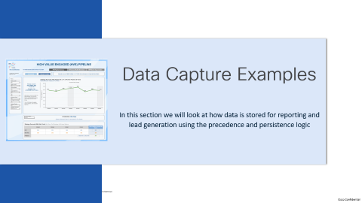
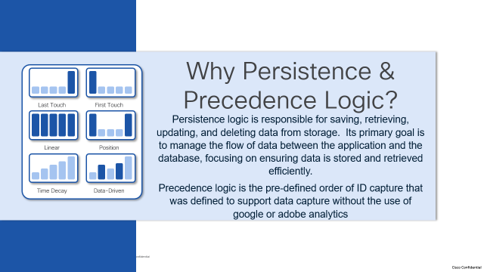

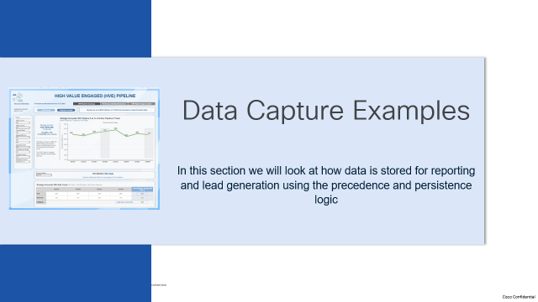
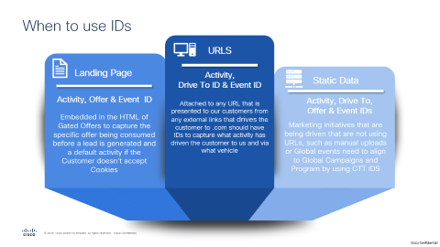
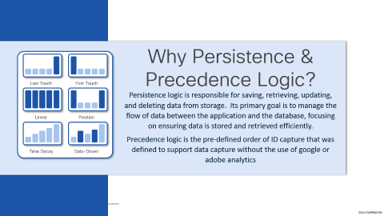
Summary Section

Slide 3
Why Persistence & Precedence Logic?
Persistence logic is responsible for saving, retrieving, updating, and deleting data from storage. Its primary goal is to manage the flow of data between the application and the database, focusing on ensuring data is stored and retrieved efficiently.
Precedence logic is the pre-defined order of ID capture that was defined to support data capture without the use of google or adobe analytics
Last Touch
First Touch
Linear
Position
Time Decay
Data-Driven
Notes:
Persistence logic is responsible for saving, retrieving, updating, and deleting data from storage. Its primary goal is to manage the flow of data between the application and the database, focusing on ensuring data is stored and retrieved efficiently.
Precedence logic is the pre-defined order of ID capture that was defined to support data capture without the use of google or adobe analytics

Slide 4
Assumption that Cookies have been accepted
Precedence Logic
Process Flow continues throughout the customers journey on .com
Determine Source of Engagement
Type
Marketing Initiative
Write URL Parameters to Local Storage for CCID and DTID
Persist with values in Local Storage
Customer Engages
Direct or Organic Search
Parameters captured include CCID and DTID
Form Submit
Persist IDs in Local Storage for 24 Hours
Check local storage for any CTT IDS
Exit .com
Yes
Continue Journey with Local Storage values
Write Offer ID from hidden tag on Gated Offer Landing Page to Eloqua
Persisted IDs
Yes
No
Align Page to Activity ID relating to keyword match of each URL touched and capture in Local Storage
Page Alignment will remain until we have confirmation that it can be removed and not impact reporting
Write Activity ID and Drive to ID Data from Local Storage to Eloqua and persist for 24 Hours
End Process
Notes:
When a customer arrives on cisco.com, we determine whether they came directly from a marketing initiative—such as email, paid search, or paid social—or from a direct or organic search.
If the customer clicks a link from an email call to action and has accepted cookies, the ccid and dtid are stored in the customer’s local storage for 24 hours and logged in our Snowflake weblog tables.
As the customer navigates the website, the URLs they visit, including any additional parameters, are captured in the weblogs, though these are not saved to local storage.
If the customer then exits cisco.com, the Activity ID and Drive To ID remain in their local storage for 24 hours. Should the customer submit a gated offer form, the Activity and Drive To IDs from local storage are written to Eloqua, and the Offer ID is captured from a hidden tag on the gated offer landing page.
If, instead, the customer arrives via a direct or organic search, we check for any IDs in local storage from a previous visit within the last 24 hours. If present, those IDs persist throughout the customer’s journey. If there are no IDs in local storage, a keyword search is performed to align the URL with a default Activity ID that corresponds to a campaign and program.
For example, if a customer lands on cisco.com, they may be assigned the ID cc001784, which is aligned with Campaign Independent, since the homepage can’t be matched to a specific campaign. However, if the customer navigates to a page with “routers” in the URL, a new ID—cc001772—aligned with the Transform Infrastructure Campaign is assigned.
If the customer clicks a call to action or page link with IDs appended, those IDs are written to the weblogs but ignored in local storage. If an organic or direct search leads to a gated offer form submission, the most recent Activity ID associated with a page is sent to Eloqua, along with the Offer ID from the landing page’s HTML.
Currently, the mapping of page URLs to IDs is under review and doesn’t include alignment with any FY25 campaigns.

Slide 5
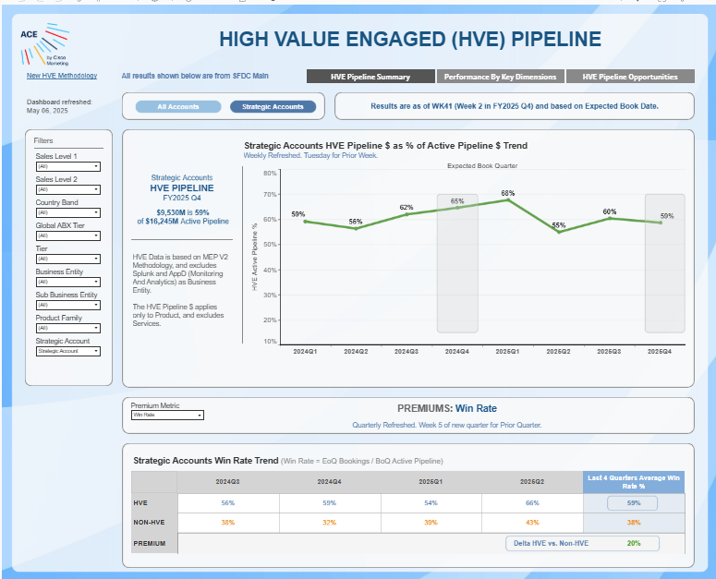
Data Capture Examples
In this section we will look at how data is stored for reporting and lead generation using the precedence and persistence logic

Slide 6
All Paths from Marketing Initiative
Start
Navigate to Industrial Security from P&S
Navigate to Explore Cisco Secure Firewall
Select option to see, try or buy a firewall
Gated Offer
Trlsc027054
Consumed
Action
Customer arrives on .com from a Marketing Email
Customer Reads blog
Customer scrolls down the page to find out more about Secure Firewall
Customer selects option to try Firewall
Data written to Eloqua and lead generated in the VDC
https://www.cisco.com/site/uk/en/solutions/transform-infrastructure/cloud-operating-model-overview.html?ccid=cc004663&dtid=oemels001119&oid=na
https://www.cisco.com/site/us/en/products/security/industrial-security/index.html?ccid=cc002176&oid=pstit024545&dtid=odicdc000509
https://www.cisco.com/site/us/en/products/security/firewalls/index.html?
https://www.cisco.com/c/en/us/products/security/firewalls/get-started.html?ccid=cc000155&dtid=odicdc000509
Last Touch:
Using Precedence and Persistence Logic the IDs aligned to the lead will be:
CCID: cc004663
DTID: oemels001119
OID: trlsc027054
Outcome
If the referring URL has parameters added for CCID and DTID then they will be written to local storage and will persist for 24 hours
All IDs on internal pages will be ignored in local storage, but will be captured in Weblogs
Offer ID will ONLY be written to Eloqua from the HTML of gated offer on a form submit
URL
Precedence Rule:
URL Parameters captured
CCID: cc004663
DTID: oemels001119
OD will be ignored in any URL
Persistence Rule:
CCID & DTID captured in local storage for 24 hours
Weblogs::Any parameters added to the URL will be captured
Precedence Rule:
No Change to CCID and DTID as the referring URL takes precedence from local storage
Persistence Rule:
CCID & DTID maintained in local storage for 24 hours
Weblogs: Any parameters added to the URL will be captured
Precedence Rule:
No Change to CCID and DTID as the referring URL takes precedence from local storage
Persistence Rule:
CCID & DTID maintained in local storage for 24 hours
Weblogs: Any parameters added to the URL will be captured
Precedence Rule:
No Change to CCID and DTID as the referring URL takes precedence from local storage
Persistence Rule:
CCID & DTID maintained in local storage for 24 hours
Weblogs: Any parameters added to the URL will be captured
Rules
Notes:
In this situation, a customer accesses cisco.com via a marketing email and subsequently completes a gated offer for a free trial of a firewall.
The customer clicks on a link in the marketing email that directs them to a cloud operation model page, which includes additional parameters to track an activity related to Transform Infrastructure and a Cross Buying Centre, along with a Drive To ID associated with an Eloqua Email and an invalid Offer ID.
If the customer consents to cookies, the Activity ID and Drive To ID will be stored in the customer's local storage, while the Offer ID will be disregarded.
All three IDs will be recorded in the Weblogs.
The customer then visits an industrial security page to read a blog, where the URL is modified to include an Activity ID linked to the IoT program and a Drive To ID corresponding to the vehicle cisco.com, as well as a product overview offer.
This appended information is logged in the Weblogs but not stored locally.
As the customer continues to explore the security pages, they click on a link to 'See Try or Buy a Firewall,' where the call to action includes an Activity ID and Drive To ID in the URL.
Again, this data is logged in the Weblogs but not saved in local storage. When the customer submits their form to request a free trial of the firewall, the Activity ID and Drive To ID that have persisted throughout the visit will be recorded in Eloqua and forwarded to the VDC to inform the seller of the customer's initial motivation for visiting cisco.com.
A hidden tag for the Offer ID will be present in the HTML of the landing page, and the value in this field will also be captured in Eloqua upon form submission and sent to the VDC to provide the seller with information regarding the specific offer the customer engaged with.
The Activity ID and Drive To ID will remain in local storage for the next 24 hours.

Slide 7
Marketing Initiative within 24 Hours of Marketing Activity
Customer Clicks on an email relating to Networking
Customer returns to .com by direct search
Navigate to P&S – Networking - Routers
Navigate to Explore Catalyst 8300
Select option to view Datasheet
Contact Cisco
Action
Customer receives email and clicks on link
Customer types in cisco.com in their address bar 24 hours later
Customer Reads blog
Customer scrolls down the page to read more about the Catalyst 8300 Series
Customer Views data sheet
Customer Selects the option for “how to buy” and Contact Cisco
Last Touch:
Using Precedence and Persistence Logic the IDs aligned to the lead will be:
CCID: cc004996
DTID: oemels001119
Outcome
If the referring URL has parameters added for CCID and DTID then they will be written to local storage and will persist for 24 hours, and page logic will mot be implemented
IDs on internal pages will be ignored
Offer ID will ONLY be taken from HTML of gated offer
Contact sales doesn’t hold an offer ID so no Offer ID is passed to the VDC
https://www.cisco.com/site/us/en/products/networking/sdwan-routers/index.html?team=digital_marketing&medium=email&campaign=cross_campaign&ccid=cc004996&dtid=oemels001119
https://www.cisco.com
https://www.cisco.com/site/us/en/products/networking/sdwan-routers/index.html
https://www.cisco.com/site/us/en/products/networking/sdwan-routers/catalyst-8300-series-platforms/index.html
? l https://www.cisco.com/c/en/us/products/collateral/routers/catalyst-8300-series-edge-platforms/datasheet-c78-744088.html?dtid=odicdc000509&oid=powit032510
URL
Precedence Rule:
URL Parameters captured
CCID: cc004996
DTID: oemels001119
Persistence Rule:
CCID & DTID captured in local storage for 24 hours and IDs stored yesterday are overwritten
Weblogs::Any parameters added to the URL will be captured
Precedence Rule:
ID Aligned to IDs in storge from the last 24 hours
CCID: cc004996
DTID: oemels001119
Persistence Rule:
CCID & DTID remains in local storage for 24 hours
Weblogs::Any parameters added to the URL will be captured
Precedence Rule:
ID Aligned to IDs in storge from the last 24 hours
CCID: cc004996
DTID: oemels001119
Persistence Rule:
CCID & DTID remains in local storage for 24 hours
Weblogs::Any parameters added to the URL will be captured
Precedence Rule:
ID Aligned to IDs in storge from the last 24 hours
CCID: cc004996
DTID: oemels001119
Persistence Rule:
CCID & DTID remains in local storage for 24 hours
Weblogs::Any parameters added to the URL will be captured
Precedence Rule:
ID Aligned to IDs in storge from the last 24 hours
CCID: cc004996
DTID: oemels001119
Persistence Rule:
IDs on internal pages will be ignored and only values captured in local storage will persist
Weblogs::Any parameters added to the URL will be captured
Rules
Notes:
In our second scenario we will be looking at a customer returning directly to .com after clicking on an email yesterday that contained an Activity and Drive to ID who wants to follow up with someone on the sales team
Customer opens browser and enters the cisco.com URL, as we have an Activity ID and Drive to ID in local storage that information is used for the rest of the customer journey.
As the customer moves around .com any URLS that are touched with IDs appended will be ignored in local storage, but will be written to the weblogs
When the customer selects the option to “Contact Cisco” the Activity ID and the Drive To ID that was captured in local storage will be passed with the lead to the VDC. No Offer ID will be passed with the lead

Slide 8
Direct Search with Marketing Activity within 24 Hours
Navigate to P&S – Networking - Routers
Navigate to Explore Catalyst 8300
Select option to view Datasheet
Selects Trials & Demos – DNA Centre
Action
Start
Customer types in cisco.com in their address bar
Customer Reads blog
Customer scrolls down the page to read more about the Catalyst 8300 Series
Customer Views data sheet
https://www.cisco.com/c/en/us/products/cloud-systems-management/dna-center/one-on-one-live-demo.html
https://www.cisco.com/site/us/en/products/networking/sdwan-routers/catalyst-8300-series-platforms/index.html?ccid=cc006547&ditid=odicdc000509&oid=anretr022498
Last Touch:
Using Precedence and Persistence Logic the IDs aligned to the lead will be:
CCID: cc001772
OID: otren015026
Outcome
No Drive To ID aligned to the lead as this came from a direct search
Pipeline aligned to Transform Infrastructure as CCID is aligned to cc001772 using keyword “router”
Offer is aligned to a trial and Demo from the HTML of the gated offer page
All internal pages with IDs appended will be ignored
https://www.cisco.com
https://www.cisco.com/site/us/en/products/networking/sdwan-routers/index.html
https://www.cisco.com/c/en/us/products/collateral/routers/catalyst-8300-series-edge-platforms/datasheet-c78-744088.html
URL
Precedence Rule:
Local Storage is checked for marketing activities in the last 24 hours
CCID: cc004996
DTID: oemels001119
Persistence Rule:
Local Storage remains for 24 hours
Precedence Rule:
IDs from local storage:
CCID: cc004996
DTID: oemels001119
Persistence Rule:
Local Storage remains for 24 hours
Precedence Rule:
IDs from local storage:
CCID: cc004996
DTID: oemels001119
Persistence Rule:
Local Storage remains for 24 hours
Precedence Rule:
IDs from local storage:
CCID: cc004996
DTID: oemels001119
Persistence Rule:
Local Storage remains for 24 hours
Rules
Notes:
In our final example, the customer was sent and email over a week ago, he clicked on the link but has taken the week to research DNA centre in a bit more detail. He finally returns to Cisco.com to take advantage of a free trial, by selecting cisco.com.
As there are no IDs in the URL parameter and no IDs stored in local storage, page logic will be applied.
The URL of the page will be matched to a keyword search in a json file and align a default Activity ID that relates to the campaign the page is aligned to.
As the first page is Cisco.Com there is no alignment to a campaign, so an ID is captured in local storage that aligns to Campaign Independent
As the customer navigates to the Products and services page and selects Networking Routers, there is a keyword match of “Routers” in the URL name, so the Default ID is updated to align to the Campaign Transform Infrastructure.
The next page has IDs appended to the URL, but these are ignored in local storage (but are written to weblogs), and another keyword search takes place on the new URL. As the keyword “routers” is again in the URL the default ID remains the same in local storage as the page is still aligned to transform infrastructure
When the customer arrives at the DNA Centre free trial the default ID is updated to a new ID (1771) that is matched on the keyword “dna-centre”
As the free trial is a gated offer the last ID in local storage cc001771 will be attached to the lead and be sent to the VDC
No Drive to ID will be aligned to the lead as this was a direct search and the Offer ID will be taken from the HTML of the landing page of the Gated Offer

Slide 9
Direct Search with no Marketing Activity within 24 Hours
Navigate to P&S – Networking - Routers
Navigate to Explore Catalyst 8300
Select option to view Datasheet
Selects Trials & Demos – DNA Centre
Action
Start
Customer types in cisco.com in their address bar
Customer Reads blog
Customer scrolls down the page to read more about the Catalyst 8300 Series
Customer Views data sheet
https://www.cisco.com/c/en/us/products/cloud-systems-management/dna-center/one-on-one-live-demo.html
https://www.cisco.com/site/us/en/products/networking/sdwan-routers/catalyst-8300-series-platforms/index.html?ccid=cc006547&ditid=odicdc000509&oid=anretr022498
Last Touch:
Using Precedence and Persistence Logic the IDs aligned to the lead will be:
CCID: cc001772
OID: otren015026
Outcome
No Drive To ID aligned to the lead as this came from a direct search
Pipeline aligned to Transform Infrastructure as CCID is aligned to cc001772 using keyword “router”
Offer is aligned to a trial and Demo from the HTML of the gated offer page
All internal pages with IDs appended will be ignored
https://www.cisco.com
https://www.cisco.com/site/us/en/products/networking/sdwan-routers/index.html
https://www.cisco.com/c/en/us/products/collateral/routers/catalyst-8300-series-edge-platforms/datasheet-c78-744088.html
URL
Precedence Rule:
ID aligned by keyword search
CCID: cc001784
Campaign: Campaign Independent
Persistence Rule:
CCID from page logic stored until next page
Precedence Rule:
ID aligned by keyword search
CCID: cc001772
Campaign: Transform Infrastructure
Persistence Rule:
CCID from page logic stored until next page
Precedence Rule:
ID aligned by keyword search
CCID: cc001772
Campaign: Transform Infrastructure
Persistence Rule:
IDs on internal pages will be ignored and only values captured in local storage will persist
Precedence Rule:
ID aligned by keyword search
CCID: cc001772
Campaign: Transform Infrastructure
Persistence Rule:
CCID from page logic stored until next page
Rules
Notes:
In our final example, the customer was sent and email over a week ago, he clicked on the link but has taken the week to research DNA centre in a bit more detail. He finally returns to Cisco.com to take advantage of a free trial, by selecting cisco.com.
As there are no IDs in the URL parameter and no IDs stored in local storage, page logic will be applied.
The URL of the page will be matched to a keyword search in a json file and align a default Activity ID that relates to the campaign the page is aligned to.
As the first page is Cisco.Com there is no alignment to a campaign, so an ID is captured in local storage that aligns to Campaign Independent
As the customer navigates to the Products and services page and selects Networking Routers, there is a keyword match of “Routers” in the URL name, so the Default ID is updated to align to the Campaign Transform Infrastructure.
The next page has IDs appended to the URL, but these are ignored in local storage (but are written to weblogs), and another keyword search takes place on the new URL. As the keyword “routers” is again in the URL the default ID remains the same in local storage as the page is still aligned to transform infrastructure
When the customer arrives at the DNA Centre free trial the default ID is updated to a new ID (1771) that is matched on the keyword “dna-centre”
As the free trial is a gated offer the last ID in local storage cc001771 will be attached to the lead and be sent to the VDC
No Drive to ID will be aligned to the lead as this was a direct search and the Offer ID will be taken from the HTML of the landing page of the Gated Offer

Slide 10
Static Data
Activity ID, Drive To ID, Offer ID, EID
URLS
Activity ID, Drive to ID & EID
Page Logic
Activity ID
Landing Page
Offer ID, Activity ID, Drive To ID, EID

Slide 11
When to use IDs
URLS
Page Logic
Landing Page
Activity,
Drive To ID & Event ID
Static Data
Activity ID
Activity, Offer & Event ID
When a customer arrives on .com from a direct or organic search and have not been engaged with a marketing initiative in the last 24 hours a keyword search takes place to align to a default ID
Attached to any URL that is presented to our customers from any external links that drives the customer to .com should have IDs to capture what activity has driven the customer to us and via what vehicle
Activity, Drive To, Offer & Event IDs
Embedded in the HTML of Gated Offers to capture the specific offer being consumed before a lead is generated and a default activity if the Customer doesn’t accept Cookies
Marketing initiatives that are being driven that are not using URLs, such as manual uploads or Global events need to align to Global Campaigns and Program by using CTT IDS
Notes:
In summary IDs can be captured in 3 main places
Appended to URL
HTML of Landing Pages
Static Transactions such as Manual Uploads, Global Event & Content Syndication Integrations
URLS
The Activity ID, Drive To ID and Event ID will only be written to local storage on the first interaction with Cisco.com for this visit
Any ID appended to internal pages or call to actions will be ignored and not written to Local Storage but will be written to Weblogs
Landing Page
The Offer ID will be taken from the HTML of the Landing Page of a Gated Offer
The Activity ID and EID will be taken from the HTML of the Landing Page – ONLY if the customer rejected cookies and we have no information in Page Logic
Automatically aligned – however, the mapping has not been updated in over a year and doesn’t align with the FY25 Campaigns

Slide 12
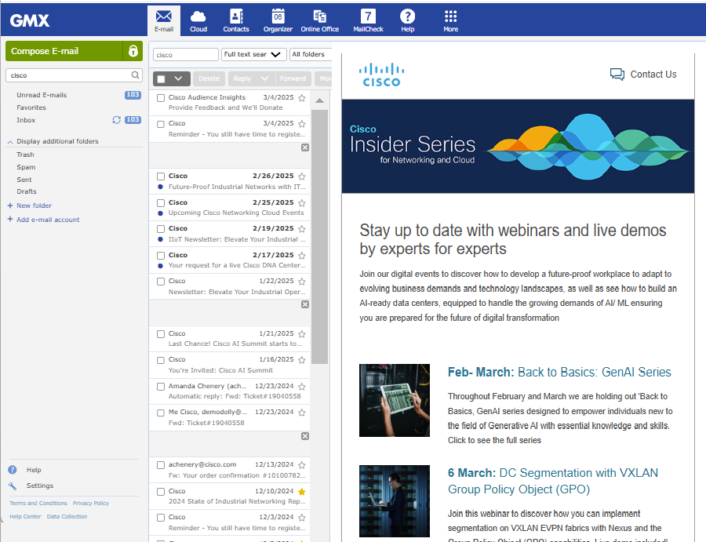
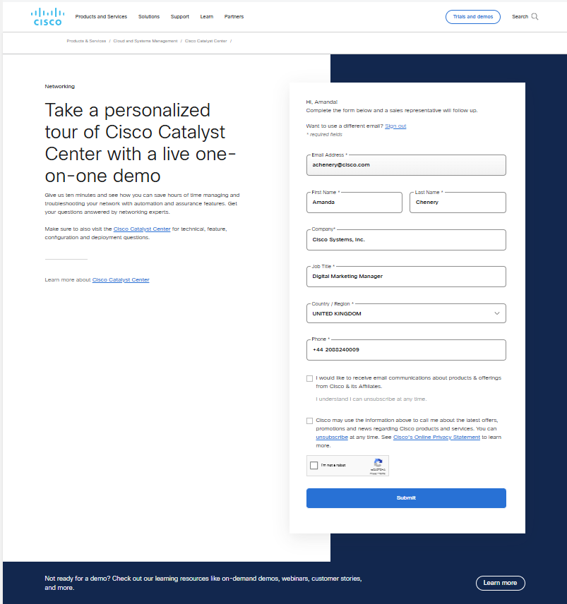
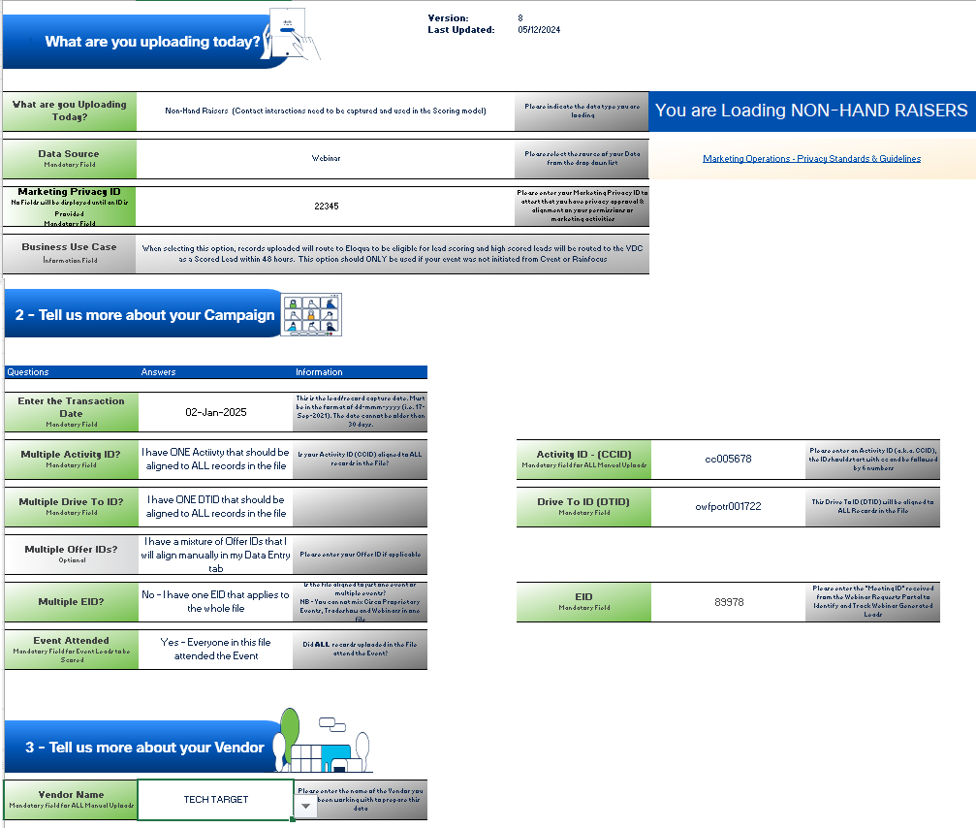

ID Examples
URL
Landing Page
Static Data
https://web.cvent.com/event/32b75903-85b2-4787-b331-cfe315921abe/summary?team=field_marketing&medium=email&campaign=transform_infrastructure&ccid=cc003016&dtid=oemels001119&eid=174744

Slide 13
Key Takeaways…..
Activity & Drive To IDs should ONLY be appended to URLS that are driving people onto .com ie Email or Social or banner link
01
02
Offer IDs should ONLY be added to the HTML of a landing page on a gated offer
IDS should NEVER be added to Internal page URLS or Call to Actions on Cisco.com
03
04
IDs are captured for ALL marketing sources and not just digital (as per UTM) such as Integrate interfaces, manual uploads and Event integrations

Slide 14
Backup Slides

Slide 15
Video Visuals
Visuals need to be redone after Arun has implemented Fix
Precedence Logic Overview
High Level overview of logic in place to capture Campaign Tagging and Tracking iDs
Organic or Direct Search
Example of Campaign Tagging and Tracking from a customers organic or direct search
Email Clickthrough
Example of Campaign tagging and Tracking from a customer clicking on an email
01
02
03

